Slide 1
ARTIFICIAL INTELLIGENCE FOR ROBOTICS II
PDDL & PDDL+
Assignment D2-V3:
Domestic Service Robot Mobile Manipulator
Q1: Classical PDDL
Q2: PDDL+
Navigation + Manipulation
A humanoid or mobile manipulator robot must prepare coffee in a kitchen where objects are distributed across multiple locations (e.g., fridge, sink, table). The robot must navigate between locations and manipulate objects.
Mahdi Baghban Ghalehchi — S6741099
PDDL & PDDL+ Domestic Service Robot Mobile Manipulator - AI4RO2
1/7

Slide 2
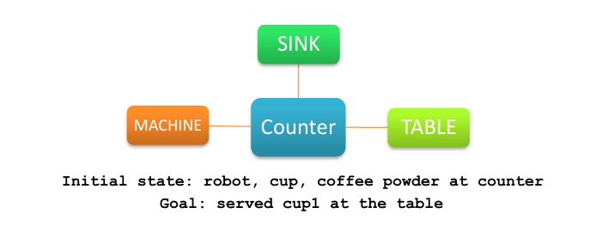
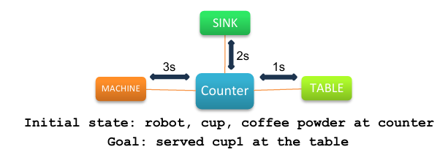
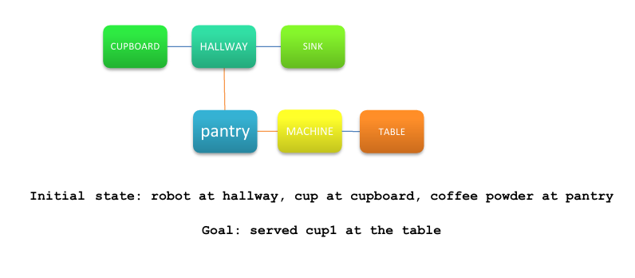
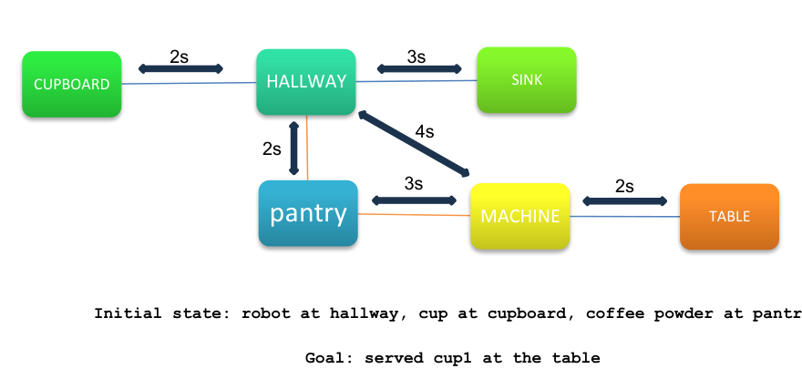
Problem & Scenario Overview
Scenario: a mobile manipulator navigates a kitchen graph to collect distributed objects, prepare coffee using functional locations, and serve it at the table.
Classical PDDL (Q1)
PDDL+ (Q2)
Simple Layout
Simple Layout
Complex Layout
Complex Layout
PDDL & PDDL+ Domestic Service Robot Mobile Manipulator - AI4RO2
2/7

Slide 3
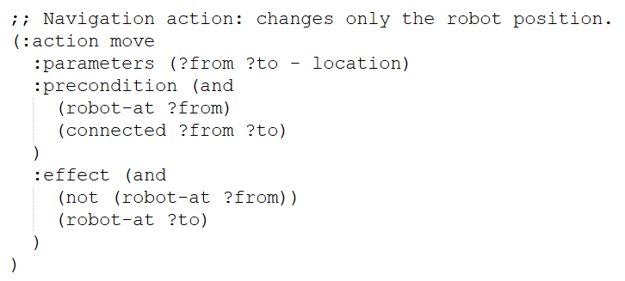
Q1 — Classical PDDL Domain Design
Type | Meaning
location | A discrete place in the kitchen graph, such as counter, sink, machine, or table.
item | A general manipulable object.
cup | A subtype of item representing the coffee cup.
ingredient | A subtype of item representing ingredients such as coffee powder.
Predicate group | Predicates | Purpose
Navigation | robot-at, connected | Encode the kitchen graph and the current robot location.
Manipulation | handempty, holding, at | Encode object location and gripper capacity.
Kitchen functionality | water-source, coffee-machine, serving-place | Make actions depend on the functional role of the current location.
Coffee state | empty, has-water, has-coffee-powder, brewed, served | Represent the causal preparation chain from empty cup to served coffee.
Action group | Actions | Purpose
Navigation | move | Moves the robot between connected locations. It changes only the robot location.
Object handling | pick-up, put-down | Allows the robot to pick and place objects only when it is at the same location as the object.
Coffee preparation | fill-water, add-coffee-powder, brew-coffee, serve-coffee | Represents the symbolic steps required to prepare and serve coffee.
Q1 DESIGN EXAMPLE — State transition for the `move` action
Action: (move counter sink)
Applied action and effects (move counter sink) delete: (robot-at counter) add: (robot-at sink)
Resulting state fragment (robot-at sink) (connected counter sink)
Repeat with applicable actions
Goal condition reached (served cup1)
Before state fragment (robot-at counter)
(connected counter sink)
→
...
→
→
→
PDDL & PDDL+ Domestic Service Robot Mobile Manipulator - AI4RO2
3/7

Slide 4
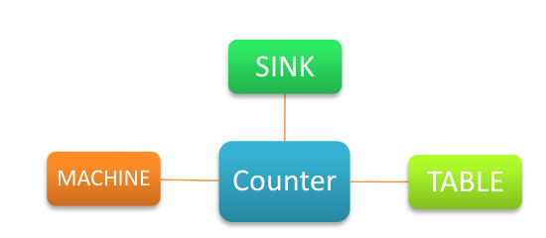
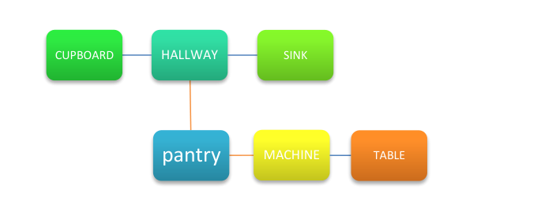
Q1 — Plan Output Walkthrough
The planner output confirms the intended behaviour: navigation enables location-dependent manipulation, while the distributed objects in the complex layout require additional movement and object-handling steps.
# | Action
1 | (pick-up cup1 counter)
2 | (move counter sink)
3 | (fill-water cup1 sink)
4 | (move sink counter)
5 | (put-down cup1 counter)
6 | (pick-up coffee-powder counter)
7 | (add-coffee-powder coffee-powder cup1 counter)
8 | (put-down coffee-powder counter)
9 | (pick-up cup1 counter)
10 | (move counter machine)
11 | (brew-coffee cup1 machine)
12 | (move machine counter)
13 | (move counter table)
14 | (serve-coffee cup1 table)
# | Action
1 | (move hallway pantry)
2 | (pick-up coffee-powder pantry)
3 | (move pantry hallway)
4 | (move hallway sink)
5 | (put-down coffee-powder sink)
6 | (move sink hallway)
7 | (move hallway cupboard)
8 | (pick-up cup1 cupboard)
9 | (move cupboard hallway)
10 | (move hallway sink)
11 | (fill-water cup1 sink)
12 | (put-down cup1 sink)
13 | (pick-up coffee-powder sink)
14 | (add-coffee-powder coffee-powder cup1 sink)
15 | (put-down coffee-powder sink)
16 | (pick-up cup1 sink)
17 | (move sink hallway)
18 | (move hallway machine)
19 | (brew-coffee cup1 machine)
20 | (move machine table)
21 | (serve-coffee cup1 table)
pick-up cup at counter
move to sink → fill-water
return / add powder
move to machine → brew
move to table → serve
Complex plan layout
Simple plan layout
start in hallway collect coffee powder from pantry carry the powder to the sink retrieve the cup from the cupboard return to the sink → fill water and add powder move via hallway to the machine → brew move to the table → serve
PDDL & PDDL+ Domestic Service Robot Mobile Manipulator - AI4RO2
4/7

Slide 5
Q2 — PDDL+ Domain Design
PDDL+ replaces instantaneous movement with a timed mechanism: an action starts movement, a process advances progress, and an event completes it.
Construct group | Elements | Purpose
Navigation action | `start-move` | Starts time-consuming navigation between connected locations. It activates `moving`, stores the origin and destination, resets `move-progress`, and sets the required movement duration.
Manipulation actions | `pick-up`, `put-down`, `fill-water`, `add-coffee-powder`, `brew-coffee`, `serve-coffee` | Represent the symbolic coffee-preparation steps. These actions remain instantaneous in Q2 because the assignment specifically focuses on time consumption during movement.
Time functions | `elapsed-time`, `deadline` | Store the total mission time and the latest acceptable completion time.
Movement functions | `move-progress`, `current-move-duration`, `move-duration ?from ?to` | Store the progress of the current movement, the required duration of the active movement, and the travel time for each graph edge.
Processes | `mission-clock`, `movement-progress` | `mission-clock` continuously increases `elapsed-time` while the mission is running. `movement-progress` continuously increases `move-progress` while the robot is moving.
Events | `finish-move`, `deadline-violation` | `finish-move` automatically completes movement when progress reaches the required duration. `deadline-violation` automatically marks failure when the deadline is exceeded.
Example movement: (start-move counter sink), with move-duration(counter, sink) = 2 time units
1. Action
2. Process
3. Event
start-move
Process: movement-progress
Numeric fluent: move-progress
finish-move
sets (moving)
origin = counter
destination = sink
move-progress = 0
current-move-duration = 2
→
while (moving):
move-progress increases
continuously over time
mission-clock also increases elapsed-time
→
fires automatically when:
move-progress ≥ current-move-duration
effect: robot-at sink
and not moving
PDDL & PDDL+ Domestic Service Robot Mobile Manipulator - AI4RO2
5/7

Slide 6
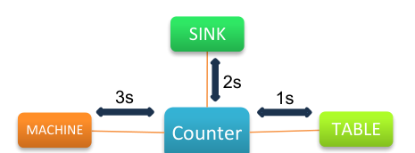
Q2 — Timed Plan Output
Time | Planner output
0.0 | -----waiting----- [1.0]
1.0 | (pick-up cup1 counter)
1.0 | (start-move counter sink)
1.0 | -----waiting----- [3.0]
3.0 | [event] (finish-move counter sink)
3.0 | (fill-water cup1 sink)
3.0 | (start-move sink counter)
3.0 | -----waiting----- [5.0]
5.0 | [event] (finish-move sink counter)
5.0 | (put-down cup1 counter)
5.0 | (pick-up coffee-powder counter)
5.0 | (add-coffee-powder coffee-powder cup1 counter)
5.0 | (put-down coffee-powder counter)
5.0 | (pick-up cup1 counter)
5.0 | (start-move counter machine)
5.0 | -----waiting----- [8.0]
8.0 | [event] (finish-move counter machine)
8.0 | (brew-coffee cup1 machine)
8.0 | (start-move machine counter)
8.0 | -----waiting----- [11.0]
11.0 | [event] (finish-move machine counter)
11.0 | (start-move counter table)
11.0 | -----waiting----- [12.0]
12.0 | [event] (finish-move counter table)
12.0 | (serve-coffee cup1 table)
Complex PDDL+ output
Time | Planner output
0.0 | -----waiting----- [1.0]
1.0 | (start-move hallway cupboard)
1.0 | -----waiting----- [3.0]
3.0 | [event] (finish-move hallway cupboard)
3.0 | (pick-up cup1 cupboard)
3.0 | (start-move cupboard hallway)
3.0 | -----waiting----- [5.0]
5.0 | [event] (finish-move cupboard hallway)
5.0 | (start-move hallway sink)
5.0 | -----waiting----- [8.0]
8.0 | [event] (finish-move hallway sink)
8.0 | (fill-water cup1 sink)
8.0 | (start-move sink hallway)
8.0 | -----waiting----- [11.0]
11.0 | [event] (finish-move sink hallway)
11.0 | (start-move hallway pantry)
11.0 | -----waiting----- [13.0]
13.0 | [event] (finish-move hallway pantry)
13.0 | (put-down cup1 pantry)
13.0 | (pick-up coffee-powder pantry)
13.0 | (add-coffee-powder coffee-powder cup1 pantry)
13.0 | (put-down coffee-powder pantry)
13.0 | (pick-up cup1 pantry)
13.0 | (start-move pantry machine)
13.0 | -----waiting----- [16.0]
16.0 | [event] (finish-move pantry machine)
16.0 | (brew-coffee cup1 machine)
16.0 | (start-move machine table)
16.0 | -----waiting----- [18.0]
18.0 | [event] (finish-move machine table)
18.0 | (serve-coffee cup1 table)
Simple Layout PDDL+ output
Deadline: 12 time units
Selected route: counter → sink → counter → machine → counter → table
Completion time: t = 12.0
Deadline: 18 time units
Selected route: hallway → cupboard → hallway → sink → hallway → pantry → machine → table
Completion time: t = 18.0
The planner output may show idle waiting intervals to advance time. They are not domain actions, not events, and not manipulation duration.
PDDL & PDDL+ Domestic Service Robot Mobile Manipulator - AI4RO2
6/7

Slide 7
Reflection & Limitations
Abstraction Gap
The robot reasons with symbolic facts and discrete locations
Physical feasibility is abstracted through predicates such as robot-at, at, connected, and holding
No trajectories, grasp poses, object geometry, or arm configurations are computed
Real execution would require motion planning, grasp planning, collision checking, and low-level control
Manipulation actions are treated as instantaneous
Only navigation consumes time
Waiting intervals only advance planner time; they are not actions, events, or manipulation duration
Suitable for symbolic task-level planning, not complete physical robot execution
Limitations and Known Issues
Possible improvements
• Add timed manipulation and connect symbolic planning to motion planning
PDDL & PDDL+ Domestic Service Robot Mobile Manipulator - AI4RO2
7/7

